Slide 1

Market Sales Prediction Using Machine Learning
Presented By - Man Desai
Supervisor: Ms. Urooj Khan (Meta Scifor Technologies)

Slide 2
Introduction
Market Sales Prediction refers to the process of forecasting future sales of a product or service within a particular market or industry.
The aim of this project is to leverage machine learning techniques to forecast market sales.
Helping businesses in making well-informed decisions when developing business strategies.
Challenges:
Data quality
Feature selection
Model complexity

Slide 3
Methodology
Data Cleaning
Data Analysis
Build Dashboard
Feature Selection
Predicting Sales
Model Training
Model Building

Slide 4
Dataset
Amazon Dataset for different categories of Amazon products.
Columns: URL, ASIN, Title, Brand, Fulfillment, Category, BSR, Subcategory, Price, Price Trends, Monthly Sales, Review Count, Reviews Rating, Number of active seller, Last Year Sales, Best Sales Period, Age (Month)
Categories: Beauty, Car & Motorbike, Clothing & Accessories, Computers & Accessories, Electronics, Health & Personal Care, Home & Kitchen, Industrial & Scientific, Musical Instruments, Office Products, Shoes & Handbags, Sports, Fitness & Outdoors, Toys & Games, Watches
Target feature: Monthly sales

Slide 5
Data Preprocessing
Handling missing values
Dropping unwanted columns
Imputing missing values
Imputing missing values based on data type.
Univariate analysis to determine data distribution.
For numeric variables:
When distribution is normal, mean was used to impute missing values.
When distribution is skewed, median was used to impute missing values.
Label Encoding for categorical features.
Feature selection to determine input features.
Notes:
Univariate
Label encoding
Feature selection

Slide 6
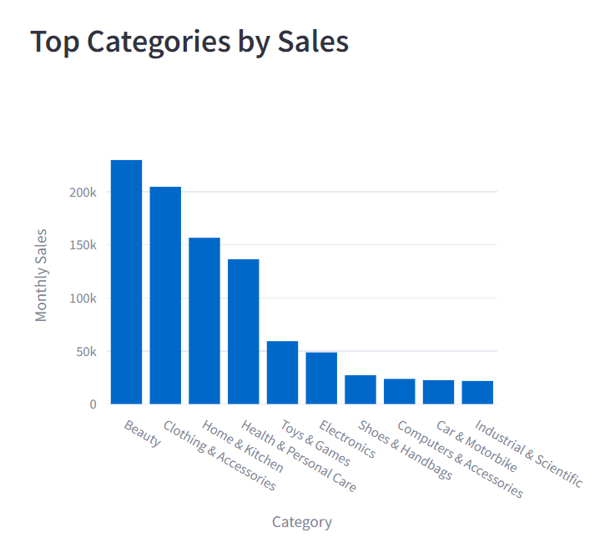
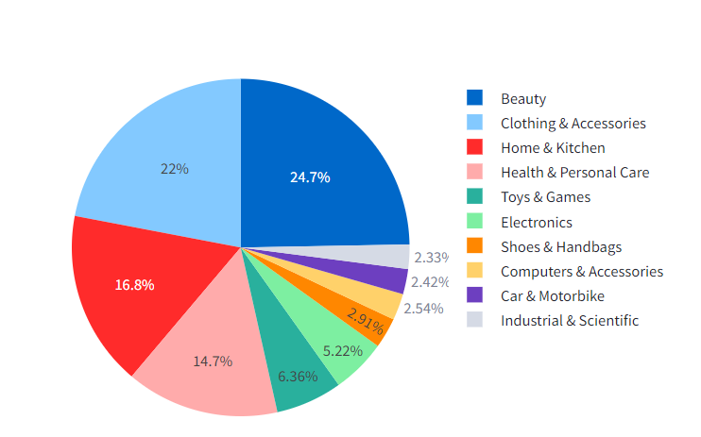
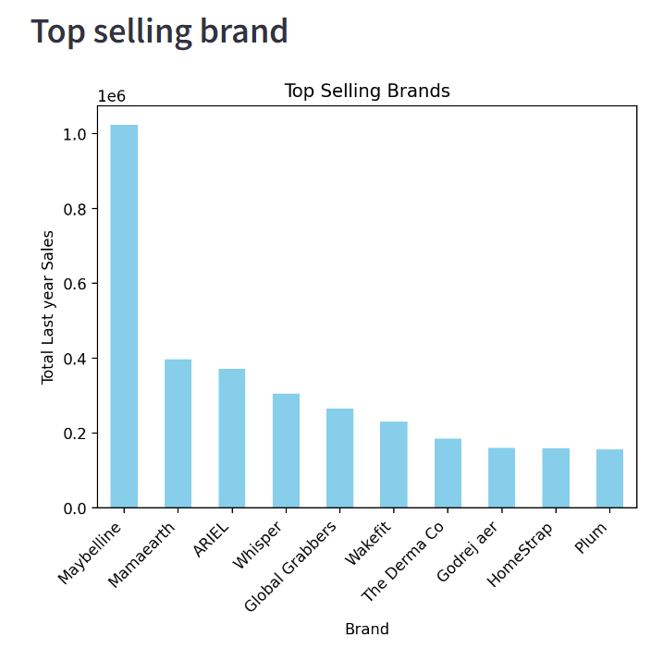
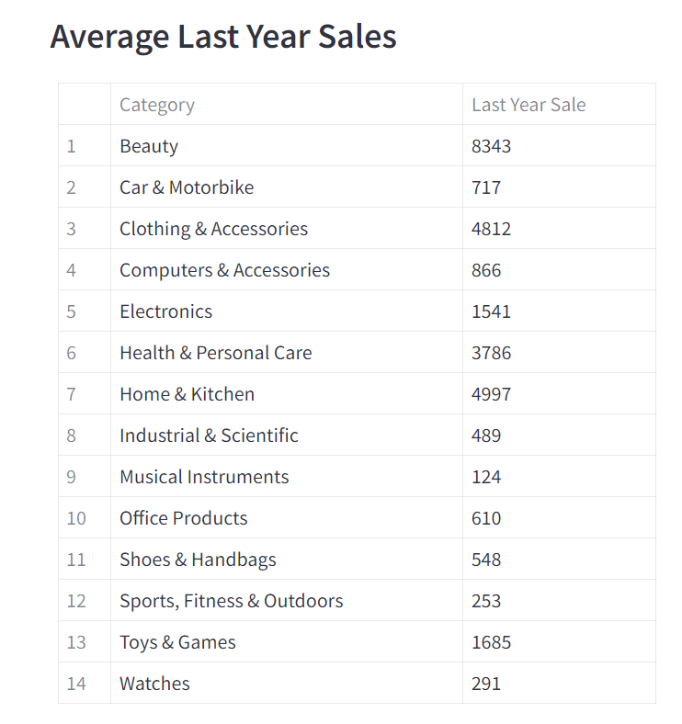
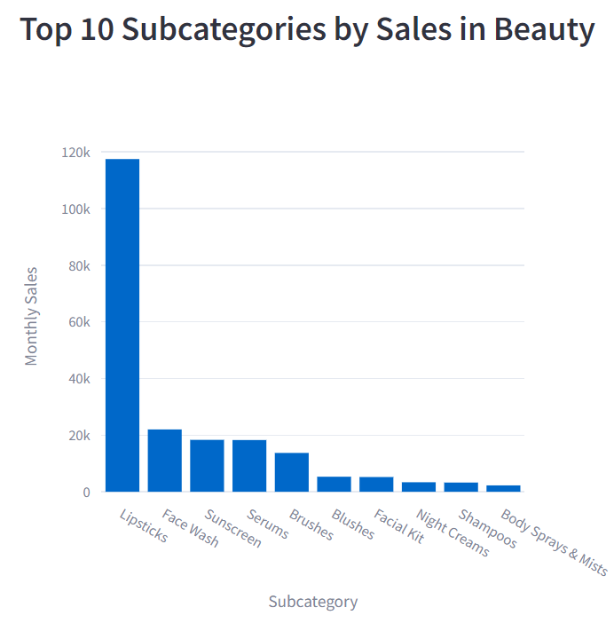
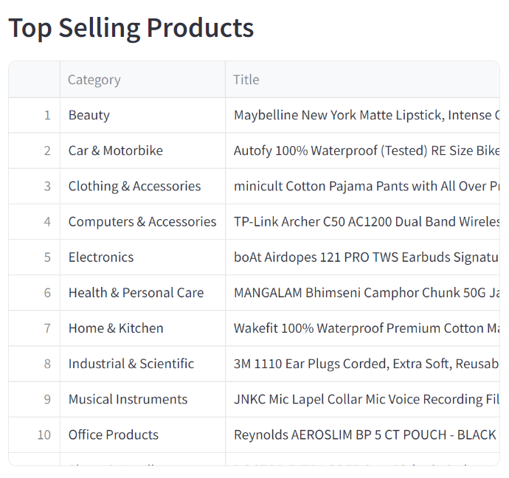
Exploratory Data Analysis

Slide 7
Model Building
Monthly_sales is the target variable that represents the quantity of a particular product sold.
Approach: Regression models chosen for predicting numeric target variable.
Models:
XGBoost Regressor
Linear Regression
Random Forest Regressor
Train-Test split: 80:20 ratio
Notes:
continuous variable
Why choose this

Slide 8
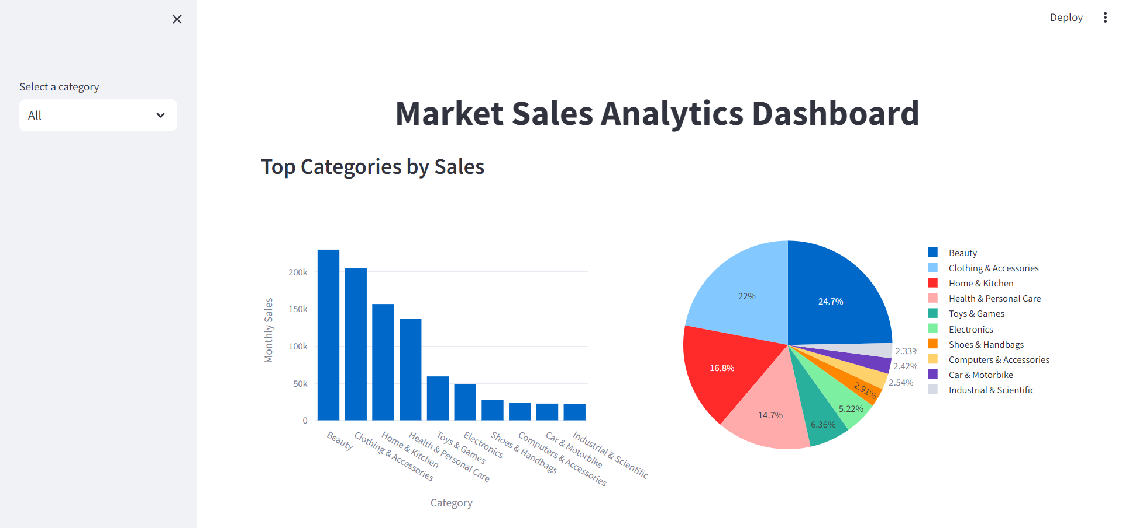
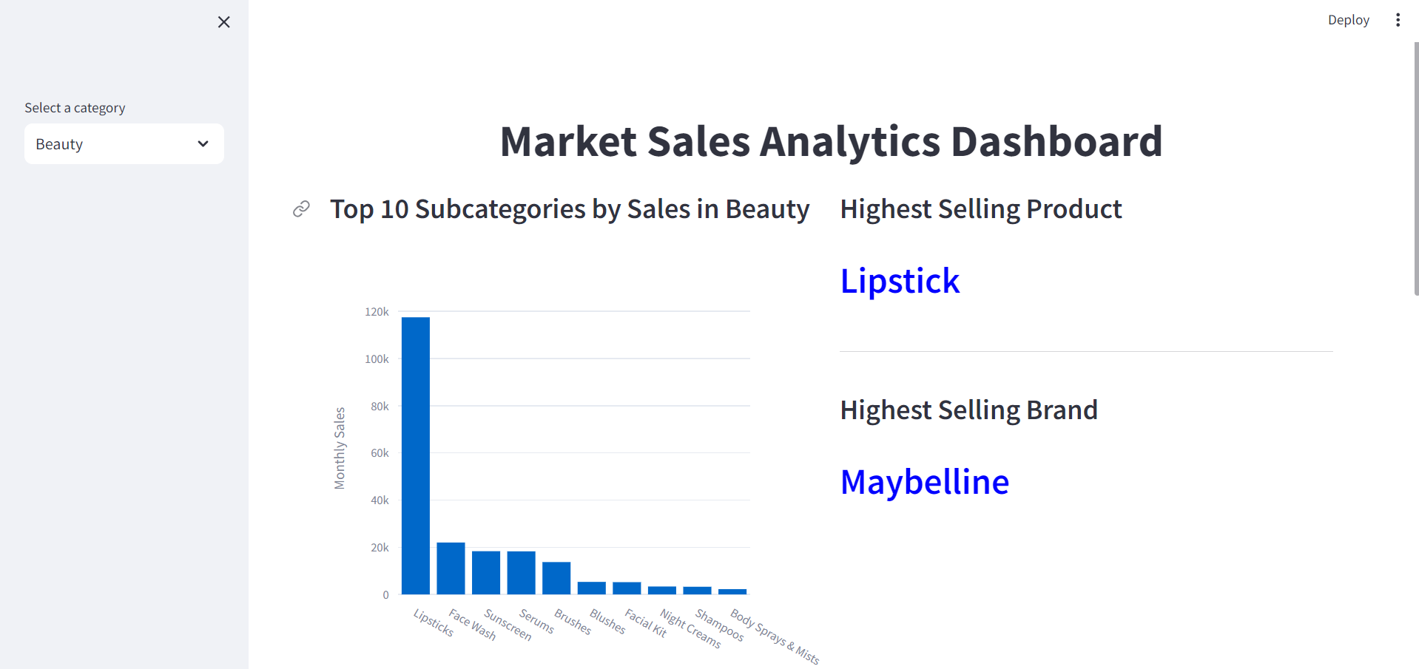
Results
The Dashboard
Fig: Overall analysis
Fig: Category-wise analysis

Slide 9
Results
Machine Learning Models
Model | Mean Absolute Error | R-squared
XGBoost Regressor | 72.9305 | 0.9316
Random Forest Regressor | 96.6088 | 0.8866
Linear Regression | 91.5141 | 0.8714

Slide 10
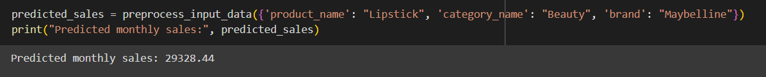
Results
Prediction
Actual Sales

Slide 11
Conclusion
By aggregating sales data over time, we can identify patterns of seasonality or specific months where sales end to peak for different product categories.
Certain products have higher demand in holiday season
Businesses can optimize their inventory management and marketing strategies by predicting monthly sales.
The dashboard provides useful insights to the retailers to identify opportunities on which products to keep in the inventory to improve sales and earn good profits.
XGBoost Regressor performs the best with the least error.

Slide 12
References
[1] M. Sajawal, S. Usman, H. Alshaikh, A. Hayat, and M. U. Ashraf, “Predictive analysis of retail sales forecasting using machine learning techniques,” vol. 6, pp. 23–33, 02 2023.
[2] “Documentation- Streamlit.” https://docs.streamlit.io/.
[3] “XGBoost.” https://www.geeksforgeeks.org/xgboost/.

Slide 13
Thank You

Slide 14
Appendix
Continuous features for which missing values were imputed:
Review count: 0 (no reviews imputed with 0)
Last year sales: Category wise median
Price Trends: Category wise mean
Label Encoded columns: category, subcategory, brand

Slide 15
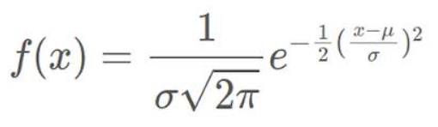
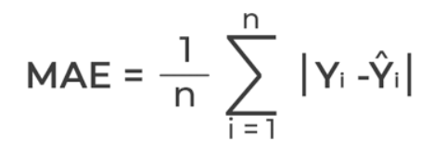
Normal Distribution:
MAE:

Slide 16
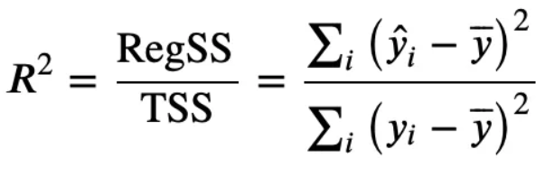
R squared:

